Slide 1
Experiential Learning Sharing Session:
Achievements in 2021/22
Dr. Theodore Lee
8 December 2022

Slide 2
Today’s flow
Observations on the alternative arrangements for EL under the pandemic
2nd EL-on-BP pilot exercise (under pandemic)
Students’ preferences of EL activities
Way forward
Q&A

Slide 3
Observations on the alternative arrangements for EL under the pandemic

Slide 4
What is alternative arrangement?
Examples of alternative arrangement
Implement EL activities on Zoom
Postponing activity implementation period
Substitute with other feasible activities
Online guest lectures/ workshops/ site visits
Flexibility in assessment requirements/ activity hours

Slide 5
Sharing from our stakeholders
EL under the pandemic
Mr. Cheng 鄭文匯老師 (External partner of GEM1039 Drama as a Creative Teaching Strategy in the Language Classroom; Teacher of HKMLC Ming Tao Primary School)

Slide 6
How have the alternative arrangements affected EL course quality in the past two years?
What challenges did students face under the alternative arrangements?
What were the good practices under the alternative arrangements that we can adopt in the future?

Slide 7
Source of data
Grade distribution
SET
Student focus group interviews
External party interview
Lecturer self-evaluation

Slide 8
Grade distributions
Commencement of
online lessons
Course | Grade | Semester 1, 2019/20 | Semester 2, 2019/20 | Semester 1, 2020/21 | Semester 2, 2020/21 | Semester 1, 2021/22 | Semester 2, 2021/22
CSLC (2018/19 cohort or before) | CR or above | 82.71% | 65.50% | 94.76% | 84.02% | 92.71% | 77.59%
CSLC (2019/20 cohort and onwards) | B or above | 76.19% | 88.38% | 93.00% | 89.87% | 91.60% | 91.28%
ELC | B or above | 79.24% | 77.92% | 83.92% | 89.08% | 81.54% | 90.86%
Grade distributions of CSLCs and ELCs showed that students’ performance remained consistent.
→ Students’ learning was not hindered by the pandemic and the alternative arrangements as both students and lecturers had adapted to the online/ alternative mode.

Slide 9
SET scores
SET Response rate | CSLC | ELC
Semester 1, 2019/20 | 26.60% | 26.40%
Semester 2, 2019/20 | 54.40% | 74.00%
Semester 1, 2020/21 | 36.57% | 53.57%
Semester 2, 2020/21 | 54.10% | 46.22%
Semester 1, 2021/22 | 49.10% | 41.46%
Semester 2, 2021/22 | 46.39% | 51.43%
Commencement of
online lessons
Commencement of
online lessons
SET overall mean scores of CSLCs and ELCs fluctuated in the 5 semesters of online lessons but were all above 3
No significant differences in the SET overall mean score throughout 2019/20 to 2021/22 for both CSLCs and ELCs
Mean SET improved in 2021/22 compared to the previous year
→ Students were adequately satisfied with the course content provided by the EL course lecturers under the alternative arrangements
Asking lecturers for strategies to boost SET response rate → Improvement in response rate in S1 & S2, 2021/22

Slide 10
Challenges in 2021/22
1. Partner organizations not available for collaboration/ f2f activities / Students having difficulties finding partner organizations on their own
2. Confusion in assessment/ activity arrangements
3. Insufficient time for planning/ implementing activities
4. Lacking engagement/ interaction with classmates/ activity targets

Slide 11
Partner organizations not available for collaboration/ f2f activities Students having difficulties finding partner organizations on their own
Contingency planning | Preparation meetings with partner organizations to plan ahead for online activities and to provide as many activities as possible Expand the number of partner organizations to help students fulfill their activity hour requirements in case some of them close down Discuss with partner organizations about the possibility of postponing the activity implementation period
Flexibility in assessment and activity arrangements | Not limiting students to only work with partner organizations for their activity, i.e. allow students to use their peers as activity targets, look for individual activity targets within their own circles/ communities Activity hours: Allow preparation work time to be included in activity hours in case students encounter unforeseen difficulties/ partner organizations cancel the activities Assessment: Ask students to submit extra essays in case partner organizations are not available for activities, and remove assessments that are not practical under the online setting
Student support in case of activity cancellation | Online consultation sessions to allow students to seek advice on their plans and contingency measures Class WhatsApp group to provide immediate support to students when partner organizations cancel activities Provide some backup partner organizations for students when they have difficulties finding one on their own

Slide 12
Confusion in assessment/ activity arrangements
Make course announcements via Moodle, Zoom and WhatsApp to remind and communicate with students frequently
Use Zoom meetings to make clarifications with entire class when there are major changes to assessment/ activity arrangements

Slide 13
Insufficient time for planning/ implementing activities
Provide a step-by-step rundown to guide students to plan and implement their activities
Have students organize weekly reflective circles in groups to report and evaluate the implementation of the proposal as a self- and group-based monitoring mechanism to facilitate progress in the implementation period.
Extend duration for students to implement activities under pandemic

Slide 14
Lacking engagement/ interaction with classmates/ activity targets
Engaging activity targets | Introduce tips for online classroom management to students, such as the selections of muting the students, use of the chat function etc. Prepare tangible materials, e.g. DIY kits, props, for activity targets to do during online activity sessions
Increasing class interaction | Use Google slides/docs, chatroom during online group discussions to keep students engaged and facilitate the immediate exchange of ideas Use online learning tools such as Kahoot, Mentimeter, Genially in class to promote learning engagement and effectiveness Conduct class online sharing activities on Moodle forum so that the class can learn how other groups have been doing

Slide 15
Way forward
Prepare contingency plans with partner organizations in case of service suspension
Maintain good communication channels between partner organizations and students
Provide assistance in helping students find partner organizations/ have backup options for them
Ensure that any changes in activity/ assessment arrangements are clearly communicated to students
Allow flexibility in requirements/ arrangements in case of difficulties
Save up samples of students’ work under online mode for future students’ reference
Summarize and share with students some good practices for organizing online activities
GEO
Continue to update “Guidelines on sustaining Experiential Learning (EL) course quality under uncertain situations” & EL handbook
→ provide guidelines for enhancement of course quality in the EL domain

Slide 16
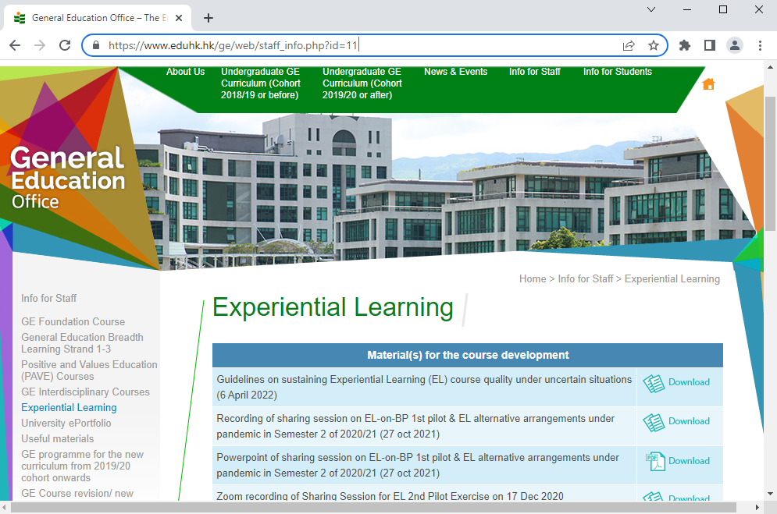
For more good practices for EL under alternative arrangements, please visit GEO homepage

Slide 17
2nd EL-ON-BP pilot exercise (under pandemic)

Slide 18
What courses were included in the 2nd EL-on-BP pilot exercise
Sem 2, 2021/22 pilot courses
Co-curricular and Service Learning Courses (CSLCs)
Experiential Learning Courses (ELC)
GEL1008 Organisation of Life Wide Learning Activities (offered by FEHD) - 8 BP students were able to carry out EL-on-BP
CSL1042/GEM1019 Community Service-based Learning in STEM Education (offered by FLASS) - due to the early summer holidays of primary and secondary schools, EL-on-BP exercise became optional
CSL1035/GEM1038 Language Carnival (offered by FHM) - BP students could complete the services before conducting BP due to the pandemic, BP students did not hold the carnival during the BP period

Slide 19
Categories of EL-on-BP
EL-on-BP inside BP school
EL ≠ a component of the BP Students should approach the Link Teacher for further negotiation and discussion on the practical arrangements of their EL activity proposals.
EL-on-BP outside BP school
Students will complete the direct service or EL activities supported by external partner organization(s) in collaboration with the EL course, rather than their BP schools. To maintain the quality and progress of BP, students should participate in all direct services/EL activities outside their BP schedules. EL course lecturers will be invited to explore the capability of accommodating BP students for early preparation prior to the start of the semester.

Slide 20
Source of data
Grade distribution
SET
Questionnaire
Student focus group interview
Lecturer focus group interview

Slide 21
Grade distributions of GEL1008
Year | Categories | Grade
 |  | Grade A- or above | Grade B- or above | W | F
2020/21 | BP students | 33.33% | 100.00% | 0.00% | 0.00%
 | Non-BP students | 11.11% | 97.22% | 0.00% | 2.78%
2021/22 | BP students | 10.00% | 80.00% | 20.00% | 0.00%
 | Non-BP students | 18.18% | 100.00% | 0.00% | 0.00%
Due to the early summer holiday, some BP schools declined the activity proposals submitted by students.
Comparison between 2021/22 and 2020/21:
Less BP students attained “Grade B- or above” (100.00% → 80.00%).
More non-BP students attained “Grade B- or above” (97.22% → 100.00%).
Students attaining “Grade F” dropped from 2.78% to 0.00% in 2021/22.
→ In general, the performance of BP and non-BP students in GEL1008 was satisfactory in 2021/22.

Slide 22
SET
SET Response rate | GEL1008 | ELCs in University
Semester 2, 2020/21 (Pilot 1) | 61.54% | 46.22%
Semester 2, 2021/22 (Pilot 2) | 56.25% | 51.43%
Indicated positive feedback and acceptance towards teaching quality provided by the course lecturer.

Slide 23
Questionnaire 1. Achievement of students in fulfilling GELOs (GEL1008 pilot course)
 | Scores (Strongly agree: 5, Agree: 4, Neutral: 3, Disagree: 2, Strongly disagree: 1) Formula: total score / total number of respondents
 | Semester 2, 2020/21 (Pilot 1) | Semester 2, 2021/22 (Pilot 2)
GELO 1: Knowledge | 3.95 | 3.76
GELO 2: Application | 4.03 | 4.00
GELO 3: Judgements | 4.00 | 4.00
GELO 4: Expression | 4.05 | 4.47
GELO 5: Awareness | 4.00 | 4.00
GELO 6: Engagement | 4.10 | 4.24
SD | 0.05 | 0.24
Response rate | 51.28% | 53.13%
Ample verbal communication through the online mode of T&L (e.g. online meetings/consultations) & more opportunities for observation through the online mode of T&L → GELO 4 & 6
The rationale of Experiential Learning: - Learning through “concrete experience” rather than acquiring “academic knowledge”

Slide 24
Questionnaire 2. Achievement of students in fulfilling GILOs (GEL1008 pilot course)
Focal GILOs for ELCs
GILO 1: Problem Solving Skills
GILO 3: Creative Thinking Skills
GILO 7: Global Perspectives (if applicable)

Slide 25
Questionnaire 2. Achievement of students in fulfilling GILOs (GEL1008 pilot course) GILO 1 Problem Solving Skills & GILO 3 Creative Thinking Skills
Average scores of GILO 1 & 3 in the two rounds of the pilot were above 4 → students generally recognized the enhancement of problem-solving skills and creative thinking skills
Further enhancement of GILO 1 & 3 in pilot 2 in comparison with pilot 1 (4.10 → 4.24) →more chance to apply & enhance both skills through organizing online EL activities during the pandemic.

Slide 26
Questionnaire 2. Practical aspects and issues arising from course delivery (GEL1008 pilot course)
 | Scores (Strongly agree: 5, Agree: 4, Neutral: 3, Disagree: 2, Strongly disagree: 1) Formula: total score / total number of respondents
 | Semester 2, 2020/21 (Pilot 1) | Semester 2, 2021/22 (Pilot 2)
1. I understand clearly the aims/ objectives of the activities. | 3.90 | 4.12 (↑)
2. I understand the expectations on my commitment in the service/ experiential learning. | 3.90 | 4.06 (↑)
3. The assessment results I received so far on this course are appropriate and suitable. | 3.55 | 3.94 (↑)
4. The course schedule was flexible and enabled me to complete my service/ experiential learning. | 4.10 | 4.35 (↑)
5. The guidance and support were sufficient for me to complete the service/ experiential learning. | 3.90 | 4.29 (↑)
SD | 0.08 | 0.17
Response rate | 51.28% | 53.13%
An overall increasing trend on students’ positive views

Slide 27
Questionnaire 3. Feasibility and achievability of the key features (GEL1008 pilot course)
 | Scores (Strongly agree: 5, Agree: 4, Neutral: 3, Disagree: 2, Strongly disagree: 1) Formula: total score / total number of respondents
 | Semester 2, 2020/21 (Pilot 1) | Semester 2, 2021/22 (Pilot 2)
6. The course enabled me to learn through experiences in planning and implementing experiential/ service learning. | 3.80 | 4.29
7. The course offered me the opportunity to differentiate ‘theory’ from ‘real life scenarios’ and to further consider their interrelationship. | 3.75 | 3.82
8. The active experience/ service hours were effectively used to promote learning in the course. | 4.00 | 3.76 (↓)
9. The course provided me with the opportunity of engaging in reflection on the processes and outcomes of experiential/ service learning. | 4.00 | 3.88 (↓)
10. The course enabled me to rethink and reassess my own values, attitudes and beliefs. | 3.90 | 3.94
SD | 0.16 | 0.21
Response rate | 51.28% | 53.13%
A relatively higher score in item 6 in pilot 2 indicated that students might have adapted in planning and implementing experiential/ service learning in an online setting.
The fifth wave of COVID-19 and its impact (i.e. the early summer holiday) had inevitably limited students’ exposure and opportunities to engage in EL activities.

Slide 28
Lecturer focus group interview
Areas of appreciation/ good practices | Suggestions/ concerns
Students’ problem-solving skills and communication skills have been developed and honed by planning and executing their activity proposals in collaboration with BP schools BP students enrolled in the EL course were sorted for course lecturer’s early preparation before the start of the semester (i.e. negotiation with partner organizations, student grouping) Usage of multiple instant messaging tools fostered efficient communication between students and course lecturers. | Course lecturer’s workload and difficulties in lesson planning would be increased by accommodating students of diverse study patterns in the same class (i.e. BP students, non-BP students, students with or without relevant subject knowledge) Setting pre-requisite(s) might be considered for easing the course implementation and maximizing the effectiveness of teaching and learning (i.e. STEM knowledge is preferred in GEM1019 Community Service-based Learning in STEM Education)

Slide 29
Student focus group interview
Areas of appreciation/ good practices | Suggestions/ concerns
Valuable opportunities to communicate with the staff member(s) of senior management of BP schools (i.e. school principal/ vice principal); social interaction skills have been enhanced Course lecturers provided adequate support and flexibility for students to design and execute their activity proposals in BP schools Acquiring skills and experience in striking a balance between school policies and students’ interests while designing extra-curricular activities Developing problem-solving skills by handling sudden unexpected situations encountered while hosting an activity in the school setting | The experience of EL-on-BP was interfered with by the early summer holidays to a certain extent; some BP schools have reservations about catering for students’ activity proposals due to the change in the BP schedule

Slide 30
Limitations
Postulated that the enrollment in the EL-on-BP scheme will remain relatively low in the future: Availability of EL courses across 8 semesters for BEd students Students’ and Course instructors’ concerns (i.e. workload, flexible schedule) BP schools’ attitude (i.e. unsuccessful matching) → GEO may need to conduct a thorough review on the practicability and necessity of EL-on-BP scheme in the future
Data lack of representativeness in the 2nd EL-on-BP pilot exercise Different evaluation methods were conducted online due to the pandemic → the response rate was relatively low (~50%), which might not fully reflect BP students’ performance 8 BP students were able to join the pilot → a small sample size
Online mode of learning for 2nd EL-on-BP pilot exercise due to the outbreak of COVID-19 Some students encountered difficulties in conducting online activities Online mode of learning probably might not fully meet the expectations of students for face-to-face interaction with service target(s) in an authentic context

Slide 31
Way forward (EL-on-BP)
Briefing sessions hosted for familiarizing students with the scheme - before the registration period of EL-on-BP - before the commencement of the FE&EL semester
Proactive communication with EL course lecturers - reminders before engaging in EL-on-BP - setting pre-requisites, if necessary, for maximizing the effectiveness of L&T - consolidation of student enrollment list for early lesson preparation

Slide 32
Sharing from our stakeholders
EL-on-BP pilot exercise
Mr. Wong Wai Hung (Course instructor of GEL1008 Organisation of Life Wide Learning Activities)

Slide 33
Students’ preference on CSLC/ELC modalities and elements

Slide 34
Students’ preference on CSLC/ELC modalities and elements

Slide 36
Most preferred ELC modality: Site visits
Most preferred CSLC service element: Internship/service to an agency
Most preferred partner organization: Schools

Slide 37
Latest development

Slide 38
Latest development (2022/23)
Implementation of 3-cp ELCs on E&I
(for FYFD programmes)

Slide 39
ELC on E&I - A new compulsory experiential learning course (ELC) on “Entrepreneurship and Innovation (E&I)” - A gradual phase-in approach would be adopted for course development, piloting and review before full implementation. There will be two versions of the E&I course:
3-cp E&I course
UGC new 4-Year programmes
UGC existing/ revamped 4-Year programmes
3-cp course with 2 cps equivalent for E&I and 1 cp equivalent for National Security Education (NSE)
UGC Senior Year (SY) new programmes
UGC SY existing/ revamped programmes

Slide 40
Remarks on ELCs on E&I
Course registration
Students can take the course offered by their or other faculties subject to its availability. Students can register for the course during the online registration period and online add/drop period. No block credit transfer (BCT) granted for ELCs on E&I for students in FYFD, and SY programmes
Failure cases
If students fail / are unable to take the course (e.g. timetable clash and late withdrawal) in the assigned semester, they should approach EIEU for make-up arrangements. EIEU should coordinate with the course offering department(s) and GEO for make-up arrangements. Course offering department(s) should perform course registration for students and inform EIEU and GEO accordingly. EIEU should then inform students of the respective make-up arrangements.

Slide 41
Students | Scenario | Actions
3-cp E&I courses (FYFD programmes) | Fulfil the minimum attendance requirement of 80% of the course (including EIEU activities) but fail the assessment | Repeat the course Retake the full range of course activities, including attendance (including EIEU activities) and all stipulated assessment tasks.
 | Fail to meet the minimum attendance requirement of 80% of the course (including EIEU activities) but pass the assessment
3-cp courses with 2 cps equivalent for E&I and 1 cp equivalent for NSE (for SY programmes) | Fulfil the minimum attendance requirement of 80% of the course (including EIEU activities and 1 cp NSE elements) but fail the assessment | Repeat the course Retake the full range of course activities, including attendance (including EIEU activities and 1 cp NSE elements) and all stipulated assessment tasks.
 | Fail to meet the minimum attendance requirement of 80% of the course (including EIEU activities and 1 cp NSE elements) but pass the assessment

Slide 42
Latest development (2022/23)
GEL1011 Study Tour Abroad: Conflict and Peace in Central Europe (IE)
EL with overseas elements pilot
*subject to students’ enrollment & development of pandemic

Slide 44
The End
Thank You!

